Slide 1


Multilingual search engine optimization (SEO)
Improve the findability of multilingual content
Digital.gov Multilingual Community of Practice
Date: October 10, 2024 Time: 2:00 pm – 3:00 pm, ET
Notes:
“Title card graphic for the event has a white background, and on the right, a flat vector illustration in shades of blue of four people at a conference room table. On the left are three sections of text in dark blue. The first line has the blue Digital.gov logo, three blue ribbons joined together in an hexagon to resemble a capital letter D, and says, Digital.gov Multilingual Community of Practice. The next section is the title of the event, Multilingual search engine optimization (SEO), Improve the findability of multilingual content. The last section gives the Date: October 10, 2024, and Time: 2:00 pm - 3:00 pm, Eastern.”

Slide 2
Agenda
Search Engine Optimization (SEO) best practices
SEO best practices for Spanish content
SEO in translation
On-page SEO
Key takeaways
Q&A

Slide 3
Search Engine Optimization (SEO)

Slide 4

What is Search Engine Optimization (SEO)?
“Search engine optimization (SEO) is the practice of enabling search engines to index and surface content.
Strong search engine optimization (SEO) fosters transparency and enhances user experience. It empowers the public to navigate complex programs, and find the information they need quickly. Accurate and informative search results improve user experience, minimizing frustration and wasted time on irrelevant pages. Creating a search experience that directs users to the information they seek reduces reliance on contact centers and other support channels. It also saves users’ time.”
Search Engine Optimization – Digital.gov, digital.gov/topics/search-engine-optimization
Entrepreneur Handbook
entrepreneurhandbook.co.uk
Notes:
Image source: What is SEO? Entrepreneur Handbook, https://entrepreneurhandbook.co.uk/what-is-seo/

Slide 5
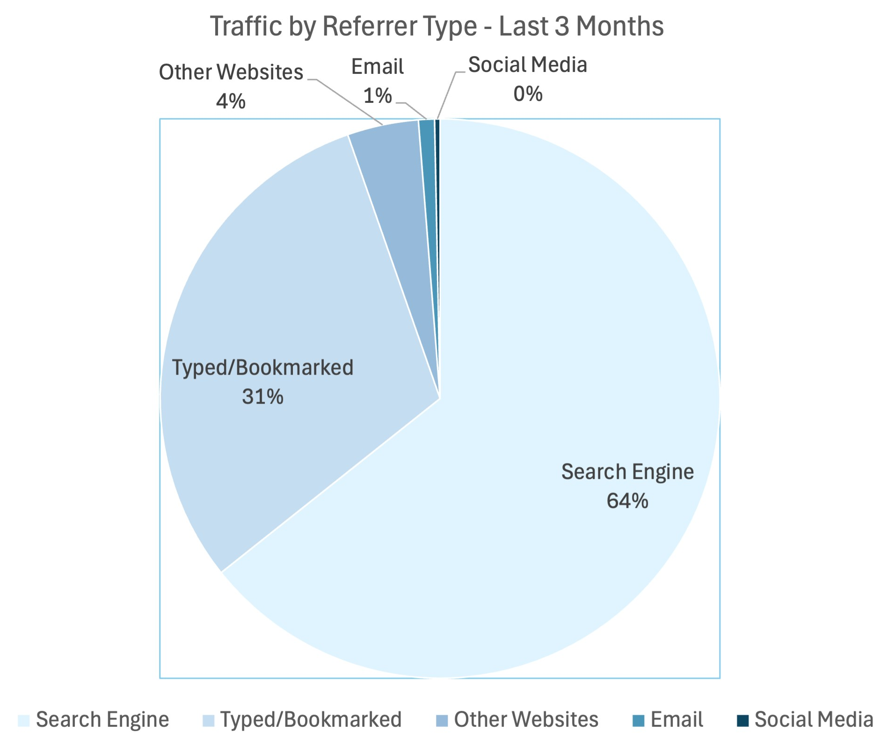
Why SEO matters
Majority of internet users find websites through search engines
Most users click on one of the top 10 search results
Higher rankings increase visibility
National Cancer Institute
Notes:
Source: National Cancer Institute

Slide 6

Best practices for search engine optimization
A team that understands:
Search engine operations (web crawlers and algorithms)
Your target audience
Information architecture
How people search the web
Navigational search
Informational search
Commercial search
Transactional search
Notes:
Image source: Publicis Sapient

Slide 7
Choose SEO tools that work best for your needs
Features and functionality
Ease of use
Accuracy and reliability
Integration capabilities
Scalability and flexibility
Support and resources

Slide 8
SEO best practices for Spanish content

Slide 9
Creating an SEO workflow
Start with SEO documentation for the English pages
Ensure a translator or terminologist in your team performs SEO for the Spanish pages
Collaborate with the team creating the English pages and your client
Review the final version to identify any missed steps
Think about where you can automate

Slide 10
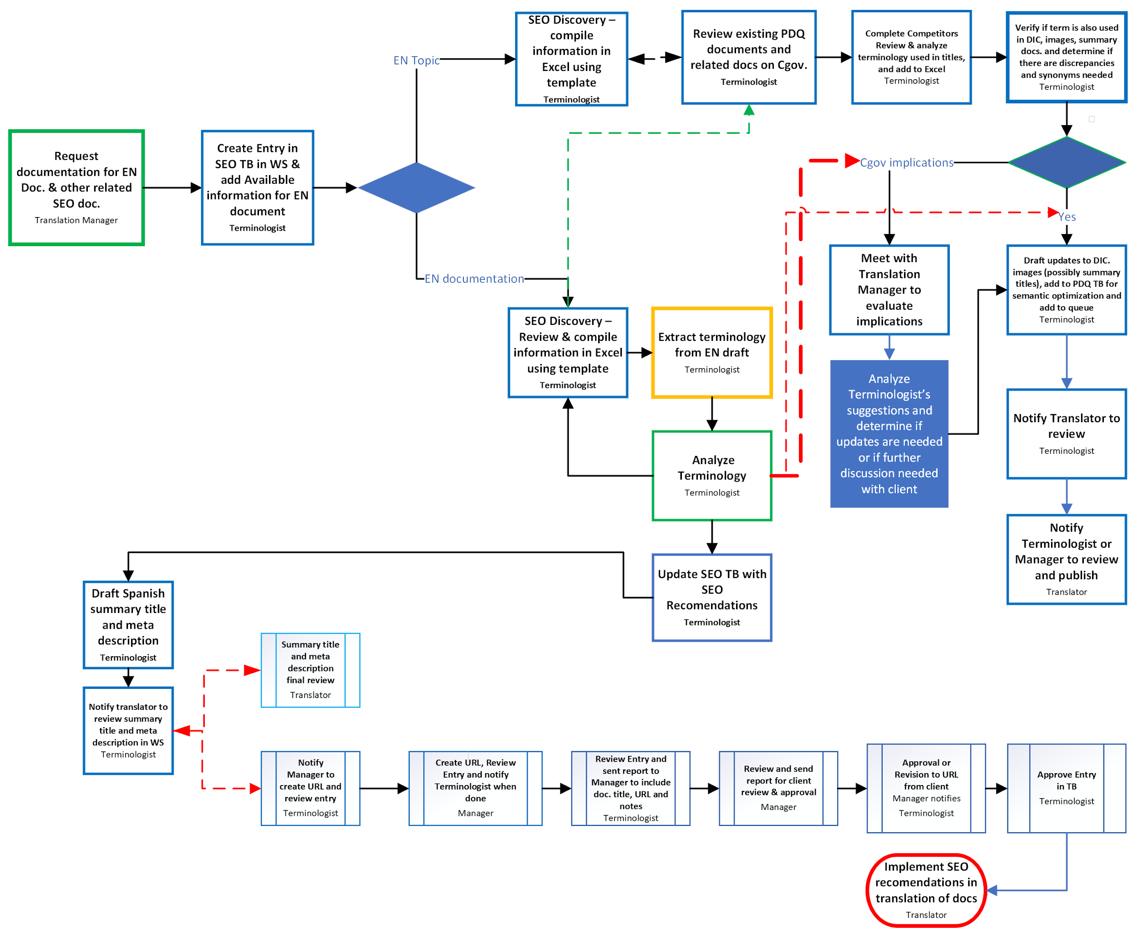
SEO workflow
Example of workflow developed for the National Cancer Institute Spanish content (cancer information summaries, dictionaries and multimedia)
Notes:
Source: National Cancer Institute

Slide 11
SEO in translation

Slide 12
Content optimization in target language
On-page (On site)
Structure
Quality Content
Meta tags
versus
Off-page
Backlinks
Marketing - exposure
Social media

Slide 13
On-page SEO

Slide 14
Use specific keywords
Keywords are words or phrases in the target language used to search the web.
Types of keywords
Primary – main topic
Secondary – semantic relevance
Examples:
"¿Qué es el cáncer de hígado?"
"Tratamiento del cáncer de hígado"
"Cáncer de hígado"
"Cáncer hepático"
“Hepatocarcinoma"

Slide 15

Components of keyword research and analysis
Gather SEO analysis for English page(s)
Understand your audience, content type and client goals
Example: Cancer.gov/espanol
Primary audience: Spanish speaking individuals in the United States
Secondary audience: Global
Notes:
Image source: DALL E 3 - MARCEL

Slide 16
Discovery in target language: know the topic of the page to be optimized
Live content
Target language - Spanish
Search engine results page analysis
Target language - Spanish
04
01
03
Competitor review
Target language - Spanish
Terminology extraction
Source text - English (candidate terms)
02

Slide 17
Spanish keyword research and analysis​
Create a list of candidate Spanish keywords
Analyze your list
Use tools (target language): Search volume, difficulty, suggestions
Validate accuracy
Finalize list of keywords and recommendations

Slide 18
Implementing on-page SEO
Examples:
"¿Qué es el cáncer de hígado?"
"Tratamiento del cáncer de hígado"
"Cáncer de hígado"
"Cáncer hepático"
“Hepatocarcinoma"
Placement of primary keywords
Title & Subtitles – H1
Metadata
First paragraph and conclusion
Don’t worry about STOP WORDS
These are common words such as “de”, “es”, “el” and “del” that search engines often ignore or give little weight to when indexing content

Slide 19
Semantic optimization: write for the topic!
Topic: secondary keywords – Don’t be afraid of synonyms
Natural: in target language – Focus on readability
Semantic density – explain complex concepts

Slide 20
Avoid these search engine penalties
Keyword stuffing
Literal translations
High search volume keywords that are inaccurate to your content (and could harm reputation)

Slide 21
Avoiding search engine penalties: images, video, and link text best practices
Create accessible titles and descriptions on images and videos in target language
Make sure your link text is in the target language: localization!

Slide 22
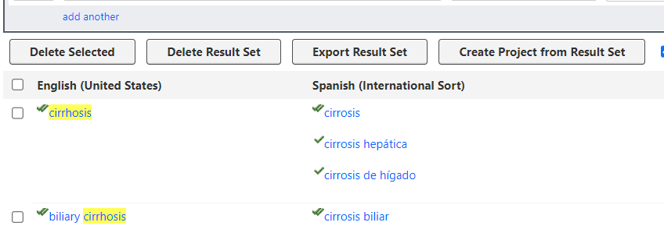
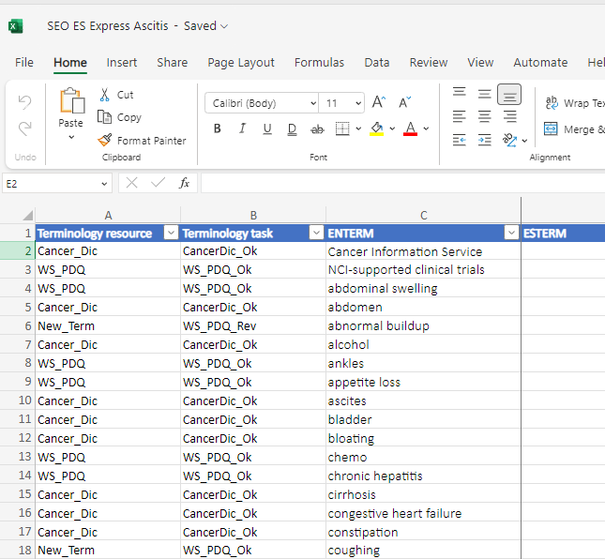
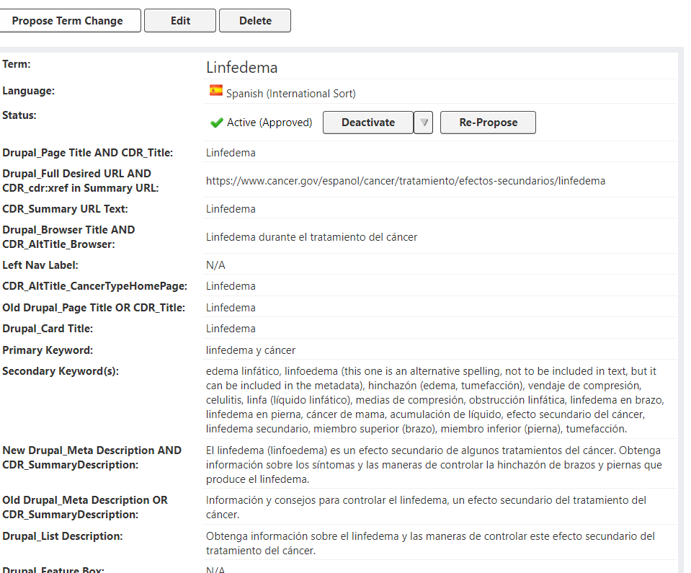
Keep records stored in SEO content worksheets & data bases
Keeping SEO data ensures translators follow SEO recommendations and makes the information easily accessible to the entire team

Slide 23
Key takeaways

Slide 24
Key takeaways
Follow SEO best practices
Understand your target audience
Localize keywords and content
Focus on translation quality
Monitor and analyze performance of your pages
Stay updated on SEO trends

Slide 25
Thank You

Slide 26
Questions?

Slide 27
Join the Digital.gov Multilingual Community digital.gov/communities/multilingual

Slide 28
Closing

